Slide 1
SAP Central Business Configuration for Implementing SAP S/4HANA Cloud
November 2-3, SAP TechEd 2023

Slide 2

Legal Disclaimer
The information in this presentation is confidential and proprietary to SAP and may not be disclosed without the permission of SAP. This presentation is not subject to your license agreement or any other service or subscription agreement with SAP.
SAP has no obligation to pursue any course of business outlined in this document or any related presentation, or to develop or release any functionality mentioned therein. This document, or any related presentation and SAP’s strategy and possible future developments, products and or platforms directions and functionality are all subject to change and may be changed by SAP at any time for any reason without notice. The information in this document is not a commitment, promise or legal obligation to deliver any material, code, or functionality. This document is provided without a warranty of any kind, either express or implied, including but not limited to, the implied warranties of merchantability, fitness for a particular purpose, or noninfringement.
This document is for informational purposes and may not be incorporated into a contract. SAP assumes no responsibility for errors or omissions in this document, except if such damages were caused by SAP’s willful misconduct or gross negligence.
All forward-looking statements are subject to various risks and uncertainties that could cause actual results to differ materially from expectations. Readers are cautioned not to place undue reliance on these forward-looking statements, which speak only as of their dates, and they should not be relied upon in making purchasing decisions.

Slide 3


SAP Central Business Configuration Vision and Business Value
SAP Central Business Configuration is a tool envisioned to let you configure a business process spanning different SAP cloud solutions from one central place based on your business needs.
Key Benefits
SAP Central Business Configuration envisioned as central configuration tool for the Intelligent Enterprise, starting with SAP S/4HANA Cloud, public edition
Increased business process flexibility and reduced configuration efforts
Reduced time to value & total cost of ownership thanks to faster implementation
Flexibility through go-lives in smaller iterative steps

Slide 4


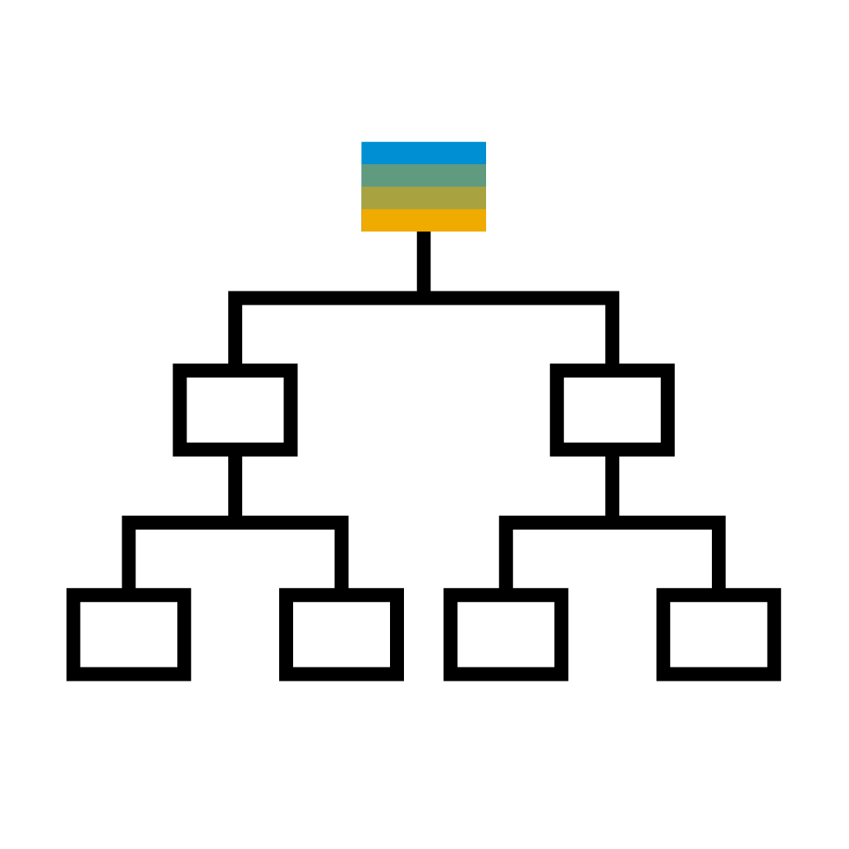


SAP Central Business Configuration Key Components
Project Experience
Scoping
Organizational Structure
Configuration
Be guided through your SAP cloud implementations
Define your solution scope by selecting countries/regions, business processes, and solution capabilities
Set up and maintain your company’s organizational structure
Tailor business processes to meet your company’s requirements
Preconfiguration Content
Fueled by the available SAP Best Practices preconfiguration content

Slide 5
SAP Central Business Configuration Process Overview
SAP Central Business Configuration allows you to manage your configurations for SAP S/4HANA Cloud, public edition implementations and ongoing operations centrally via Project Experience. You can initiate change anytime to make additions to your scope, countries/regions, and organizational structure or make changes to your configuration settings.
Scope
Organizational Structure
Product-Specific Configuration
Define scope
Assign deployment target
Specify primary finance settings
Set up organizational structure
Deploy settings to development system
Perform configuration activities

Slide 6
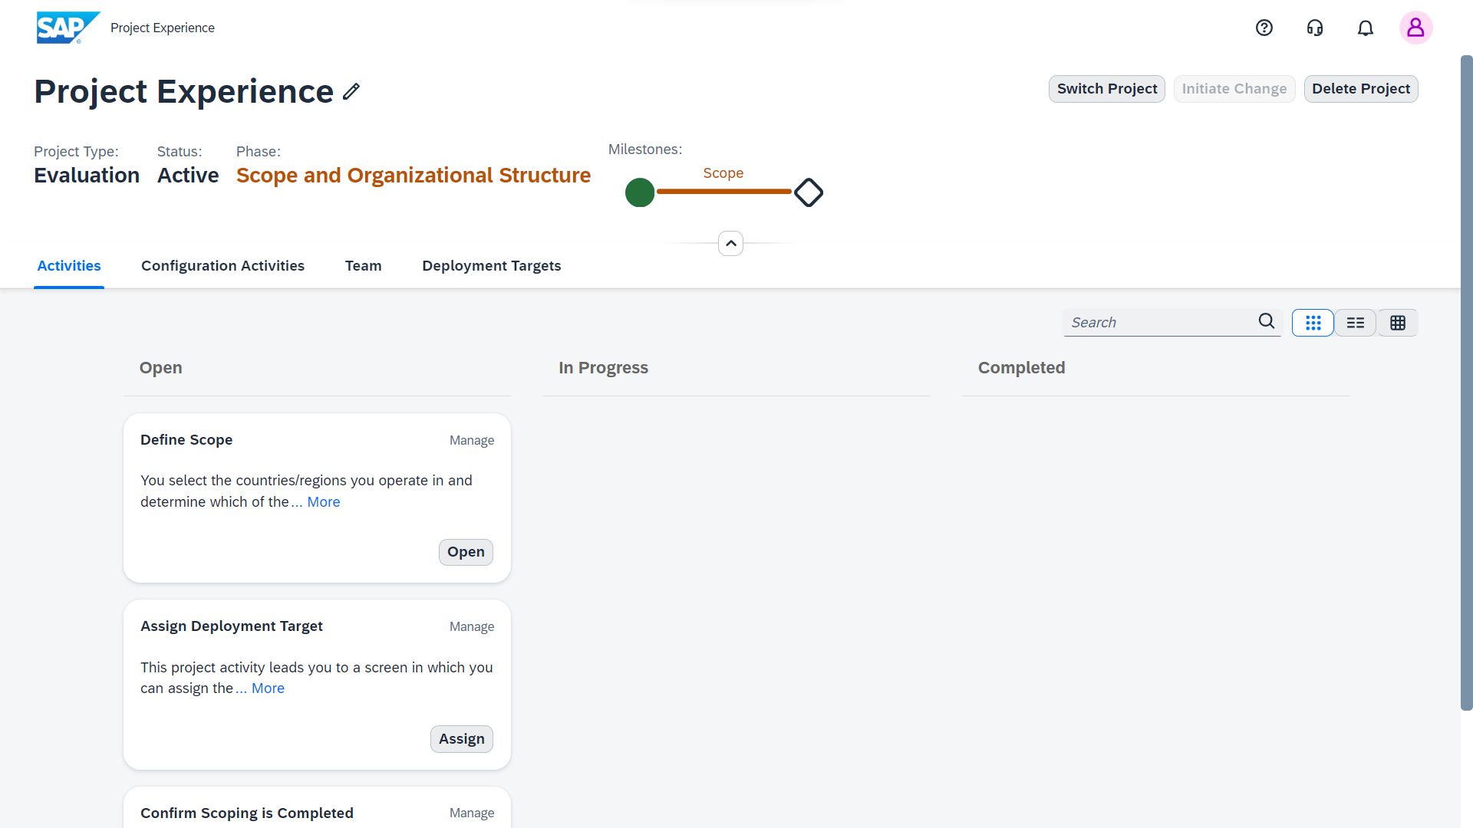
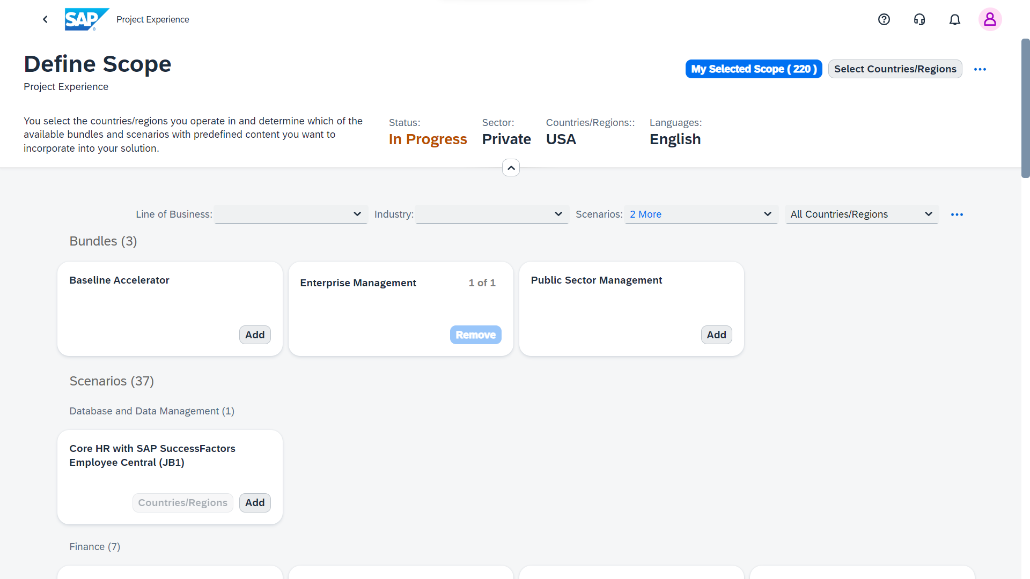
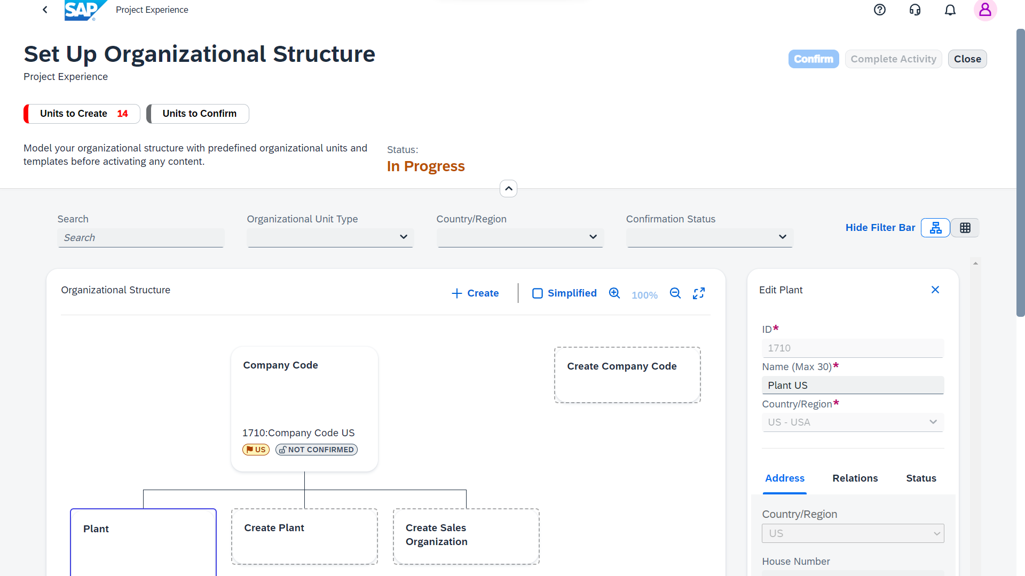
Evaluation Project Explore your business processes before starting the implementation project
Create an evaluation project and assign it to a suitable system such as the SAP S/4HANA Cloud starter system.
Explore your business processes with a preselected scope and sample data.
Begin the implementation project anytime.

Slide 7
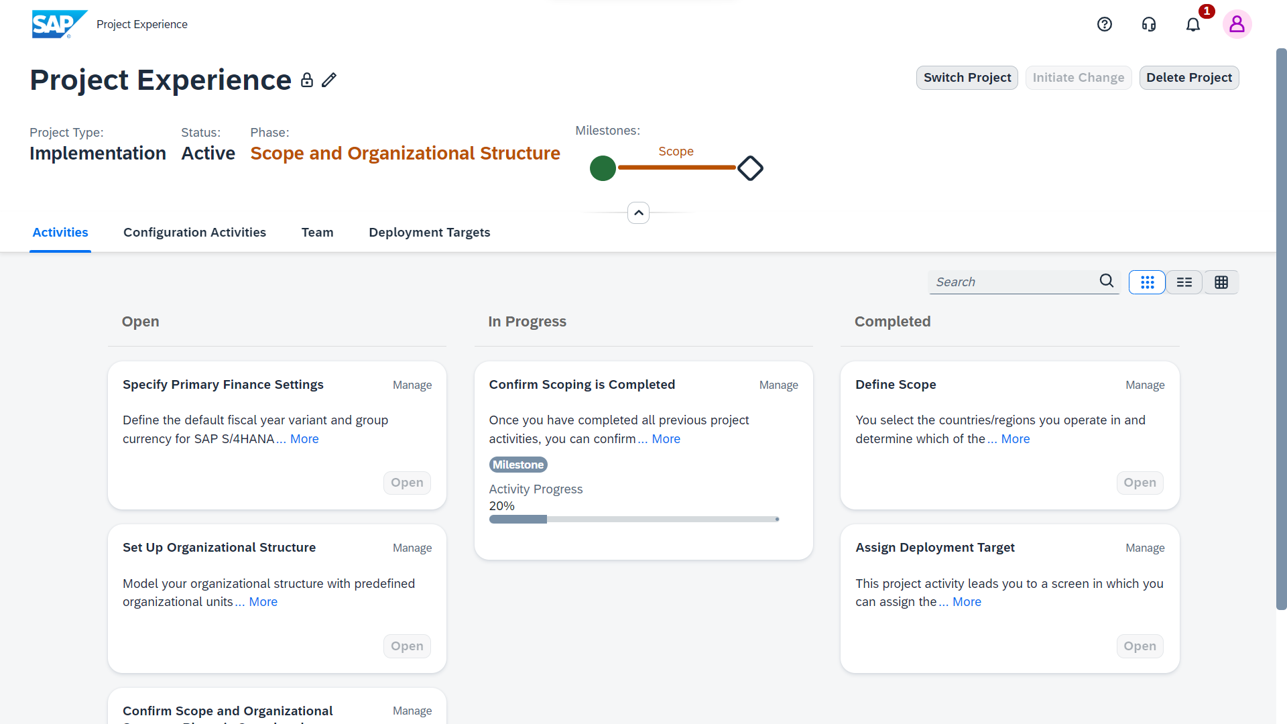
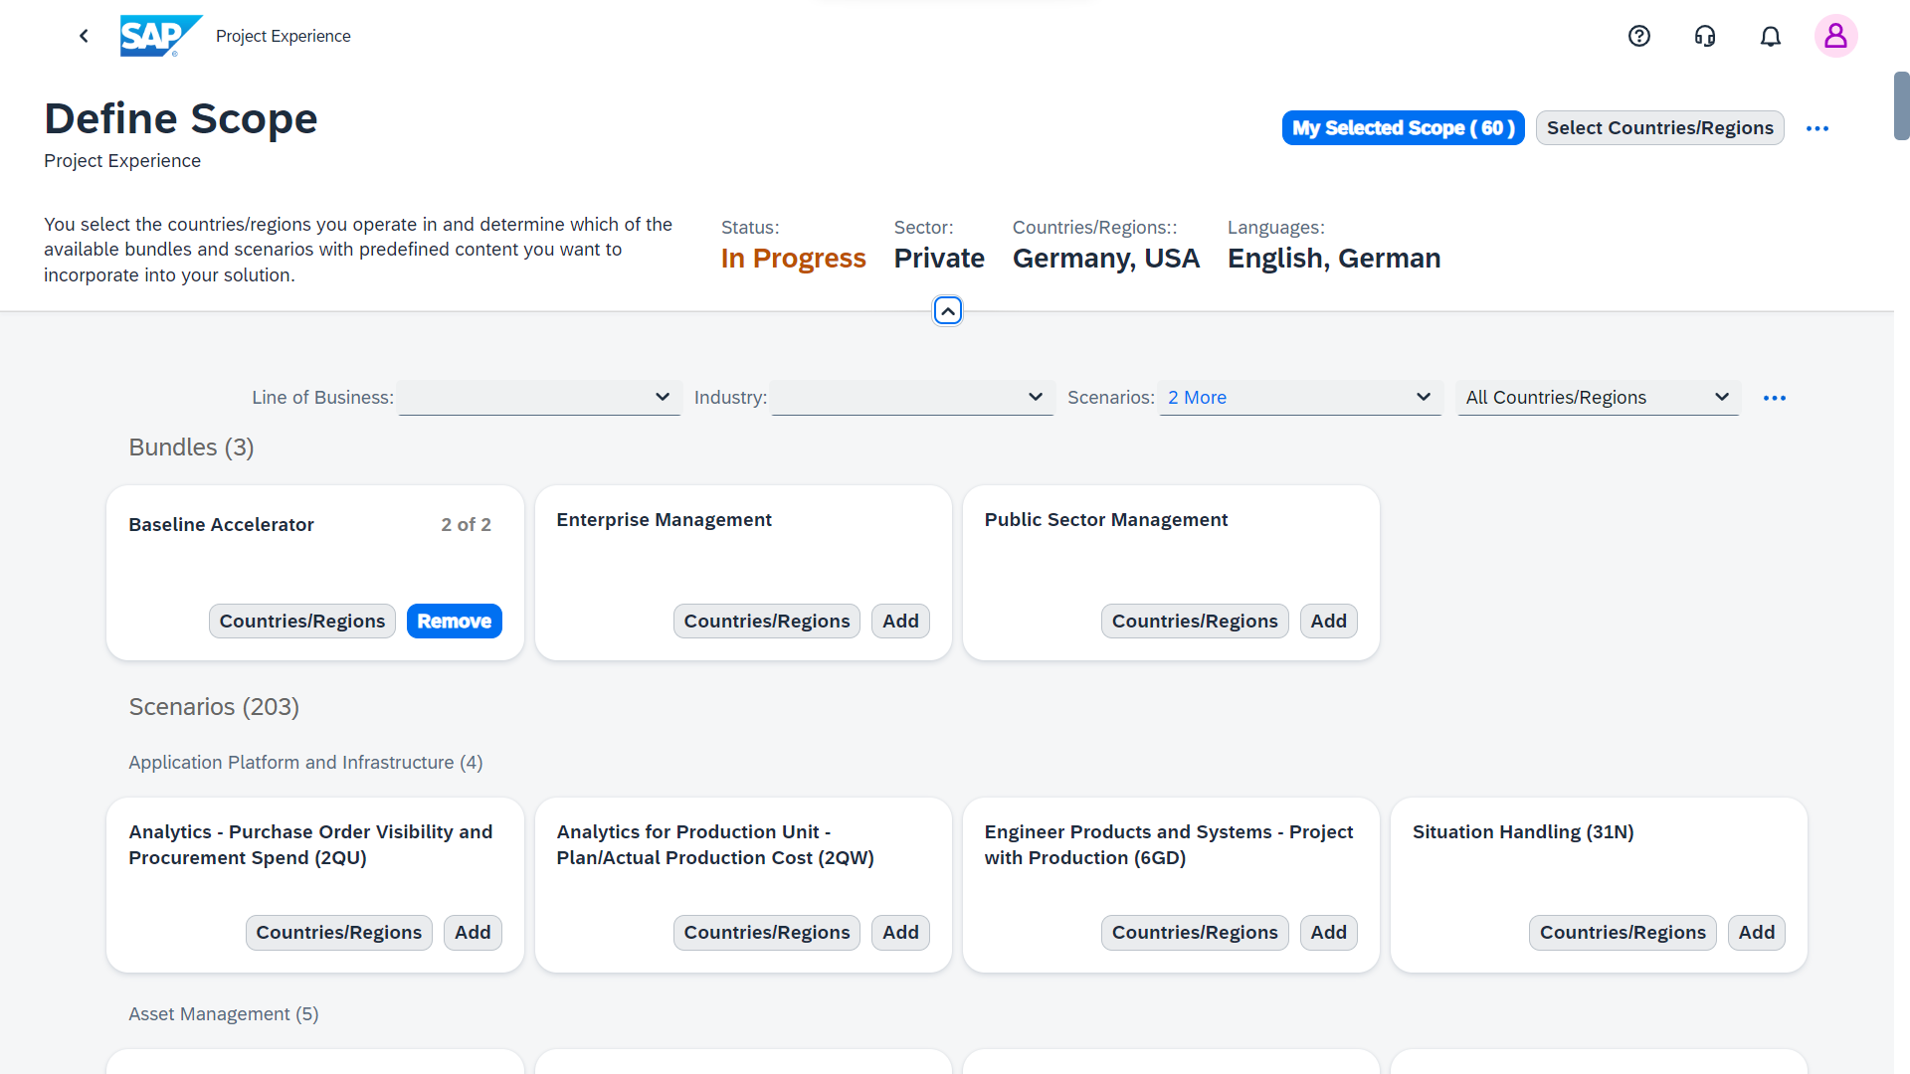
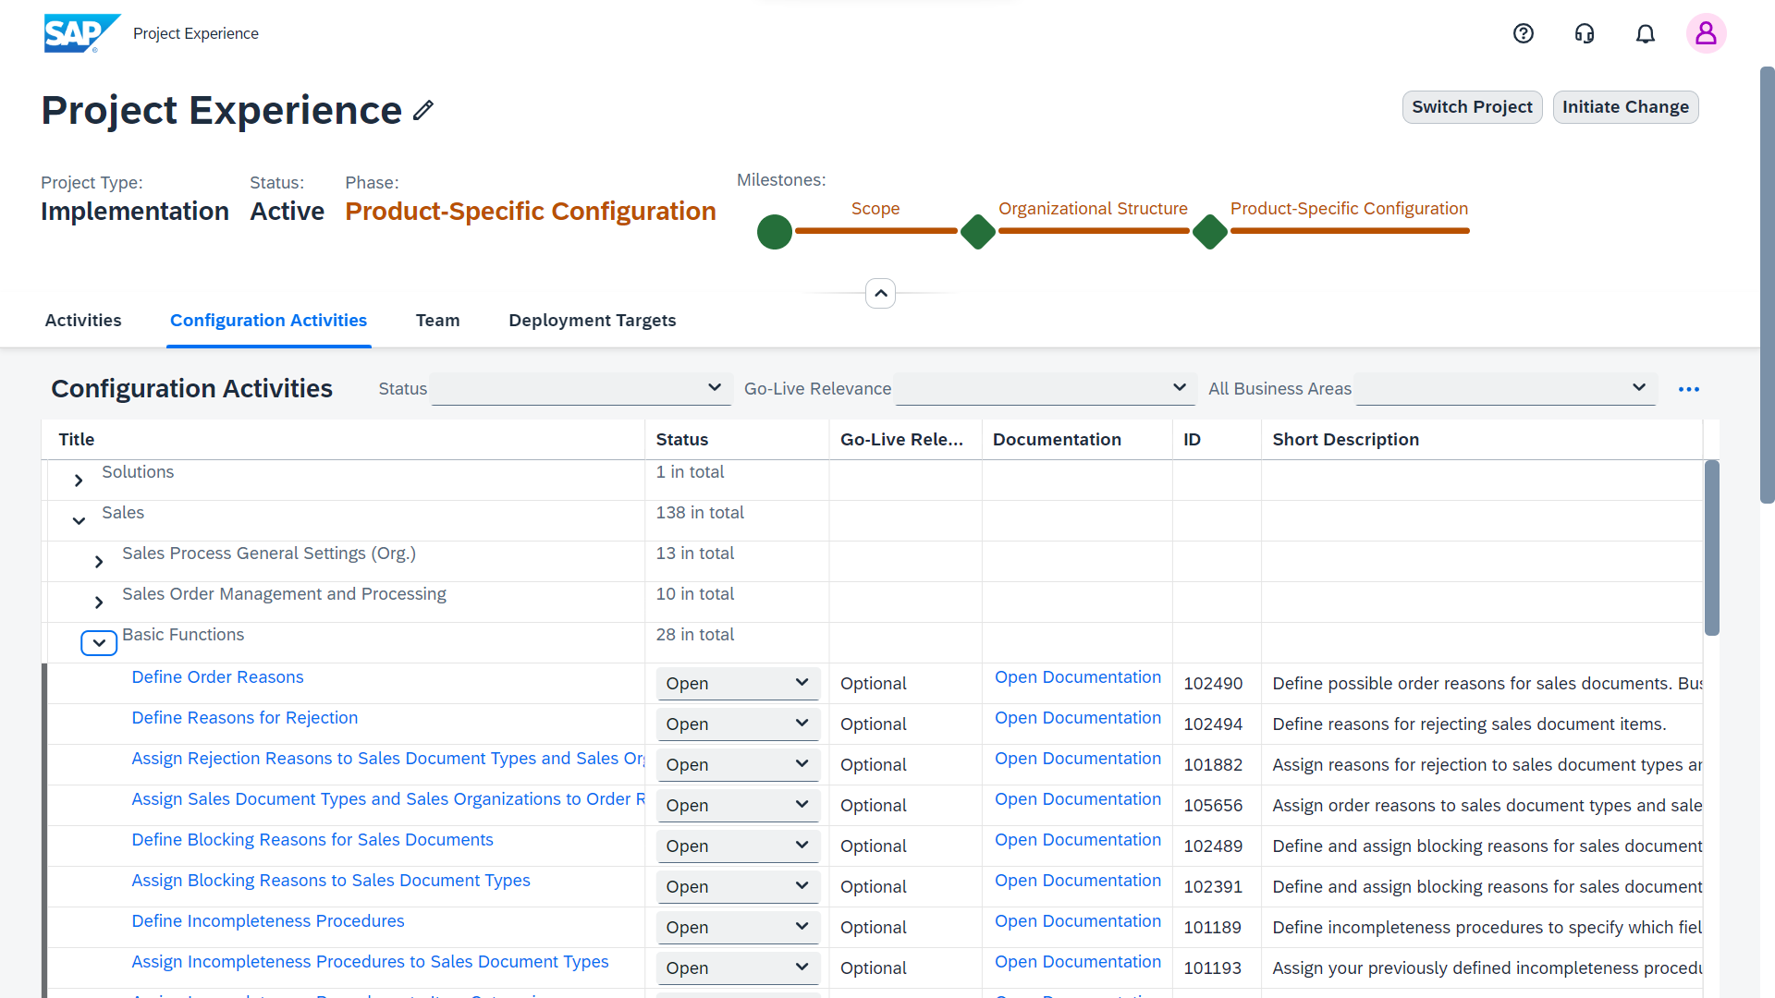
Implementation Project Manage your initial implementation and ongoing operations
Project Experience Manage configurations for implementations and ongoing operations centrally and be guided through your project.
Define Scope app Define the solution scope for your implementations.
Set Up Organizational Structure app Easily create and adapt your company’s organizational structure.
Configuration Activities Centrally configure business processes to meet your company’s requirements.

Slide 8

Project Experience
Project Experience allows you to manage your configurations and ongoing operations for implementations centrally.
Key features:
Project guidance and activity management
Central access to further apps (for example, Define Scope or configuration activities)
Central access to SAP cloud installations (SAP S/4HANA Cloud first)
Customer-driven change projects (to enhance scope/countries, organizational structure, or configuration settings)

Slide 9
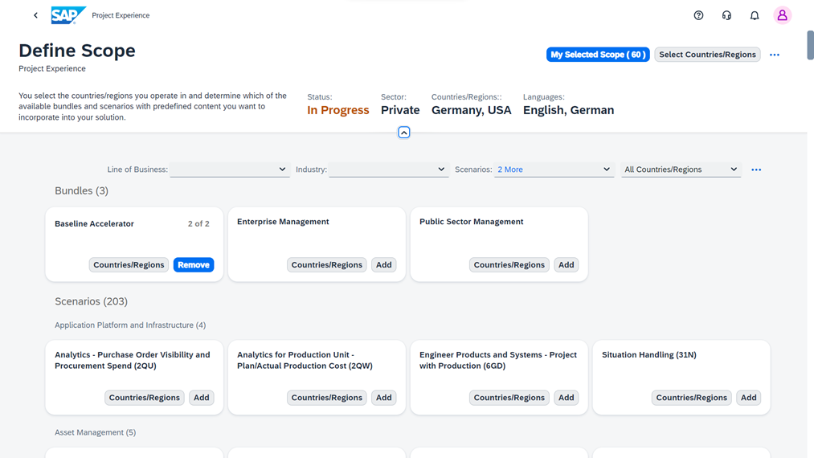
Define Scope
The Define Scope app allows you to define the solution scope for your implementations centrally.
Key features:
Scoping of SAP cloud solutions (SAP S/4HANA Cloud first)
Scoping of multiple countries/regions at once
Selection of a bundle with predefined scenarios of a certain business focus (for the USA and Canada, even a bundle for public sector scope is available)
Flexible selection of non-standard (optional) and license-dependent scenarios per country/region

Slide 10

Organizational Structure Management
The Set Up Organizational Structure app allows you to easily create and adapt your company’s organizational structure (org structure).
Key features:
Graphic view – graphical, scope-dependent, and guided creation of organizational units
Table view – all org units are listed in a table
Org structure can be set up as draft and reviewed before activation. Deleting and changing units and assignments is possible anytime before confirming them.
Checks in place to make sure all mandatory organizational units and relations based on the selected scope have been created

Slide 11
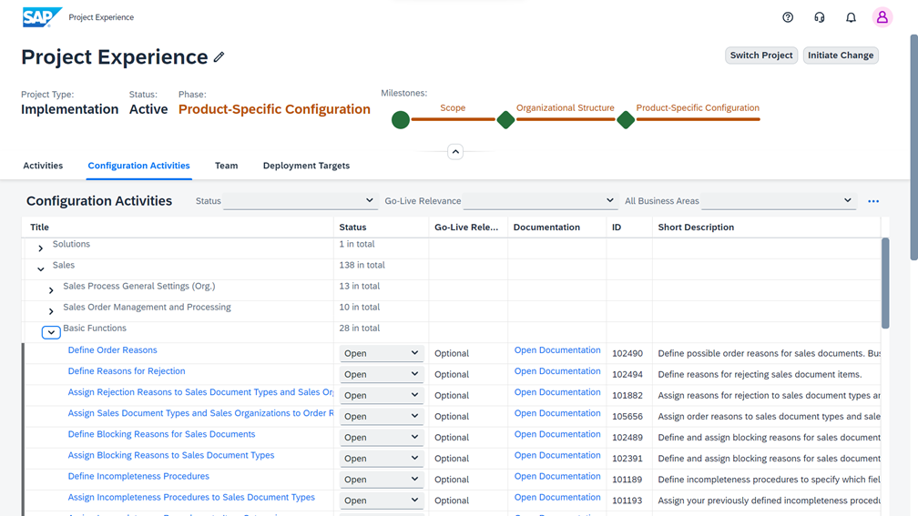
Product-Specific Configuration
By performing configuration activities, you can centrally tailor business processes via SAP Central Business Configuration to meet your company’s requirements.
Key features:
Configuration activities take your scope and country selections into account
Flexible ledger setup and assignment of accounting principles
Flexible chart of accounts and renumbering of G/L accounts

Slide 12
Configuration Localization Tool
Approach​
The Configuration Localization Tool (CLT) is a technically easy-to-use approach for partners and customers to create a new local version.​
It generates localized configuration settings for a target country/region from a selected source country/region (Germany).
➢ Business configuration content to jump start localization​
Basically, CLT ensures that localized configuration for a target country/region is generated consistently with preconfigured configuration settings and can be adapted in an implementation project.​
Purpose​
With CLT, SAP and partners can expand the coverage of SAP S/4HANA Cloud, public edition to countries which haven’t been possible so far (also not with the private edition) ​
CLT – What is it?

Slide 13
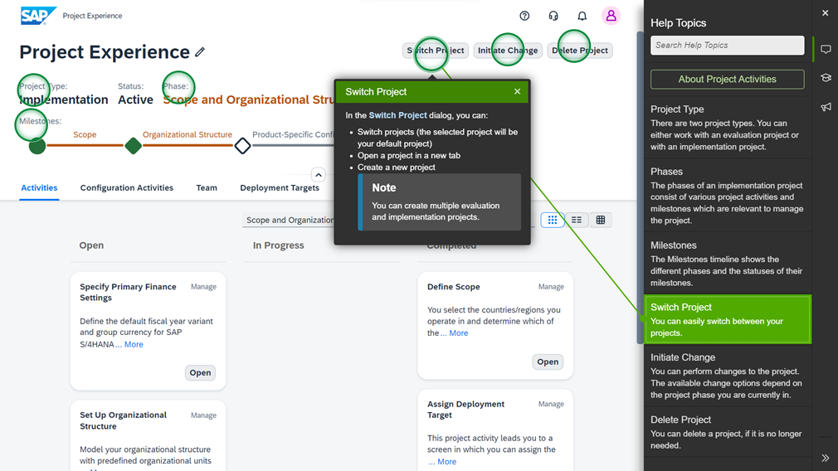
In-App Help
Embedded help for instant context-sensitive user assistance. Users can open the in-app help by clicking on the question mark icon at the top of the screen.
Key features:
On-screen descriptions for quick assistance
Interactive learning tutorials that take you step-by-step through the project activities
What’s New information about the latest features and changes
Context-sensitive direct links to relevant sections of the comprehensive documentation on the SAP Help Portal (depending on your current screen)

Slide 14


3-System Landscape For New Customers Since Sept. 2022
SAP S/4HANA Cloud, public edition
Besides a starter system, the 3-system landscape consists of a development system, test system, and production system
Transports to the development system are handled via SAP Central Business Configuration
Transports from the development system to the test system and to the production system are handled in SAP S/4HANA Cloud
SAP Central Business Configuration
Development System
Test System
Production System
Development Workspace
Deploy
Development Tenant
Export
Workspace
Customizing Tenant
Import
Import
Test Tenant
Production Tenant
Import your code with abapGit
Forward
Starter System
Development Workspace
Deploy
Starter Development Tenant
Workspace
Starter Customizing Tenant

Slide 15


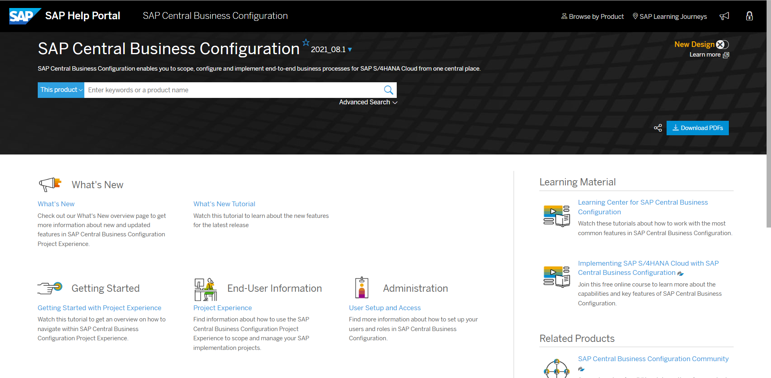
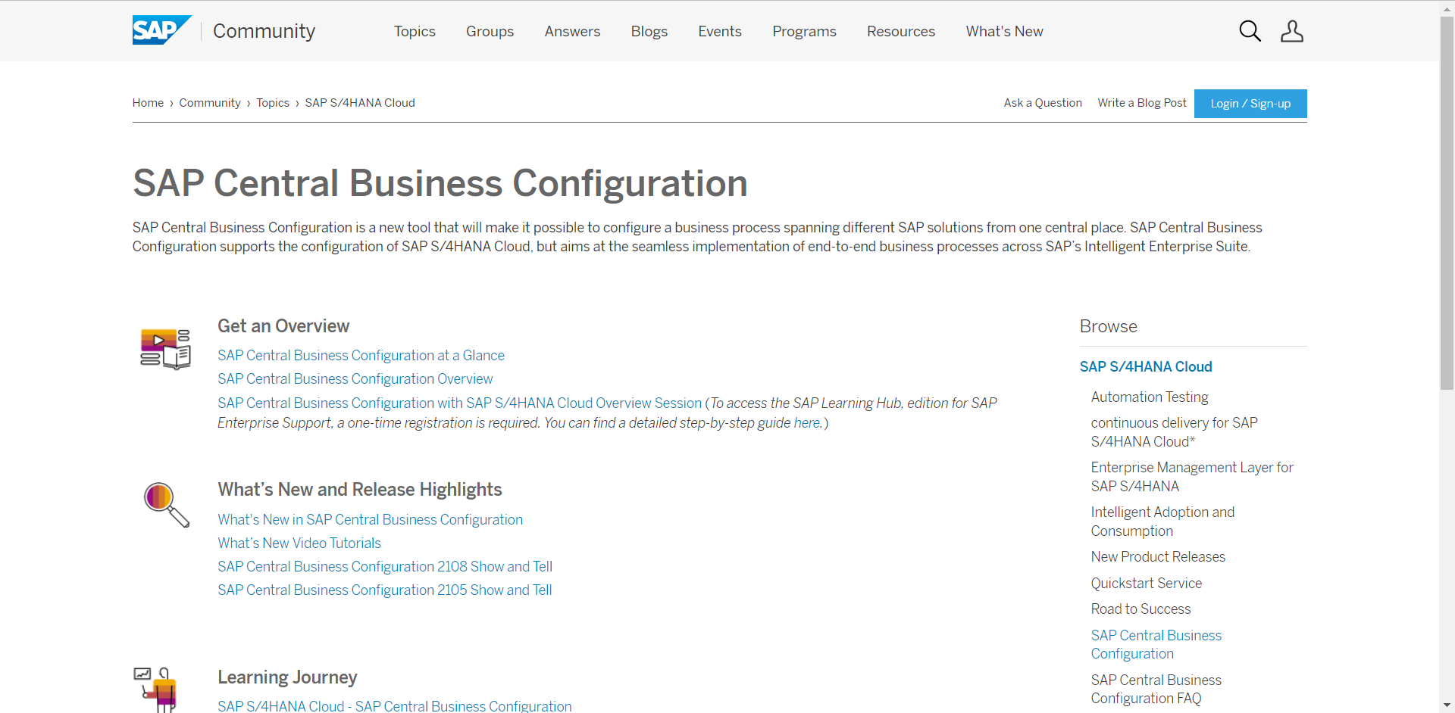
Additional Resources
SAP Central Business Configuration Product Page
SAP S/4HANA Cloud
Community Page
Check out the product page for SAP Central Business Configuration on the SAP Help Portal to find documentation and further learning content:
Visit the community page for SAP Central Business Configuration to access additional resources, such as overview slide decks and recorded live sessions.
User Setup and Access guide
Project Experience guide
Security guide
What’s New information
Tutorial Library with click-through tutorials
FAQs

Slide 16

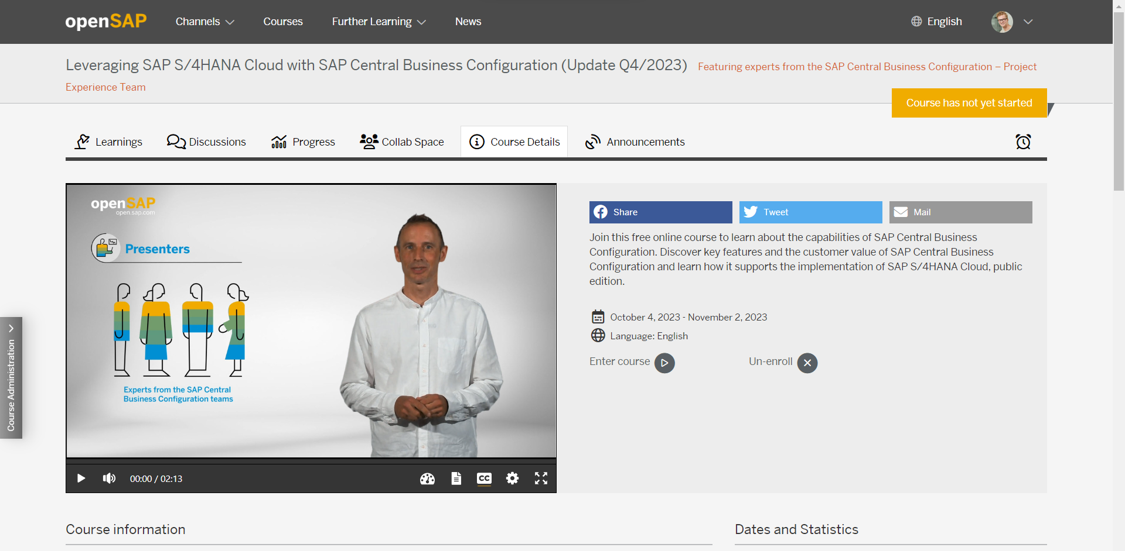

Additional Resources
openSAP Course
Take part in the free openSAP course about SAP Central Business Configuration to get a clear overall picture and deep dive into various aspects.
SAP Customer Influence Portal
Any ideas about how to improve our software? SAP customers and partners can now submit and vote on improvement requests for SAP Central Business Configuration on the SAP Customer Influence Portal (S-user required). To learn more, you can read this blog.

Slide 17
Thank you
November 2-3, SAP TechEd 2023
srikanth.golla@sap.com
tanush.parihar@sap.com
poonam.pedneker@sap.com

Slide 18

Feedback for DT164
You can use Mobile app or Web Link too
Use this QR code to Provide Session Feedback

